Slide 1


A Hybrid Deep Learning Approach
MULTIMODAL BIOMETRICS FOR DISEASE DETECTION

Slide 2

GROUP MEMBERS
Himanshi Baherwani
Jasleen Kaur
Saniya Gupta
01

Slide 3
INTRODUCTION
This project aims to detect skin diseases using facial images.
Facial regions are automatically extracted from input images.
Important features such as skin texture and color are analyzed for disease detection.
The system compares new images with known cases to identify possible diseases.
It is designed to be simple, effective, and works well in different lighting and skin tone conditions.
02

Slide 4
ABOUT THE DATASET
The dataset tells about various skin diseases and how they can be indentified using the hybrid models . It contains 20 skin diseases directories with face images
03

Slide 5
DIFFERENT MODELS FOR OUR PROJECT
1.KNN
2.CNN
3.SVM
4. HAAR CASCADE
5. HYBRID
04

Slide 6
HAAR CASCADE
HAAR Cascade is a method used for detecting objects in images, like detecting a disease in a photo.
It works by scanning an image quickly and checking for patterns (features) that match what a disease usually looks like.
It uses many small boxes (called features) to find parts of the disease
It's fast and good for face disease detection, especially in real-time applications .
In disease detection, HAAR Cascade is often used in the first step—to detect and crop the disease before analyzing it with deeper models.
05

Slide 7
K-NEAREST NEIGHBORS (K-NN)
We use the K-Nearest Neighbors (KNN) algorithm to detect skin diseases from facial images.
KNN works by comparing a new image to stored examples using distance measures like Euclidean distance.
Features such as texture and color are extracted and normalized for accurate comparison.
The algorithm finds the ‘k’ most similar cases (neighbors).
It predicts the disease based on majority voting among those neighbors.
KNN is easy to use, interpretable, and effective for small datasets.
It handles different skin tones, lighting conditions, and noise well.
This makes it a reliable method for early, image-based skin disease detection.
06

Slide 8
CONVOLUTIONAL NEURAL NETWORKS (CNN)
CNN is a powerful deep learning model used to analyze images.
It can automatically learn important features from images, like spots, patterns, textures, etc.
It’s made up of layers that help it see more complex details step by step.
It’s very good at recognizing diseases from medical images, like skin rashes, eye scans, or facial features.
In disease detection, CNNs are often used after getting the image (maybe using HAAR), to learn from it and make a diagnosis.
07

Slide 9
SUPPORT VECTOR MACHINE (SVM)
We use SVM (Support Vector Machine) as a classifier to detect skin diseases from extracted features.
SVM works by finding the best boundary (hyperplane) that separates different disease classes.
After extracting features (like texture and color) from facial images, SVM classifies them into disease categories.
It is especially effective when the data is not too large and is well-separated.
SVM is known for high accuracy and works well with high-dimensional data.
It helps improve precision and reliability in skin disease detection.
08

Slide 10
HYBRID HAAR CASCADE-CNN MODEL
We use HAAR Cascade to detect and crop the face region from input images.
HAAR Cascade quickly scans the image and finds face-like patterns using light-dark feature comparisons.
Once the face is detected, it is passed to a CNN (Convolutional Neural Network).
CNN automatically learns deep features from the cropped facial image, such as skin texture, spots, or discoloration.
These learned features are used to classify the image into a specific skin disease.
This combination improves the accuracy and speed of the system.
HAAR + CNN ensures the system focuses only on the relevant facial region, reducing noise and irrelevant background.
09

Slide 11
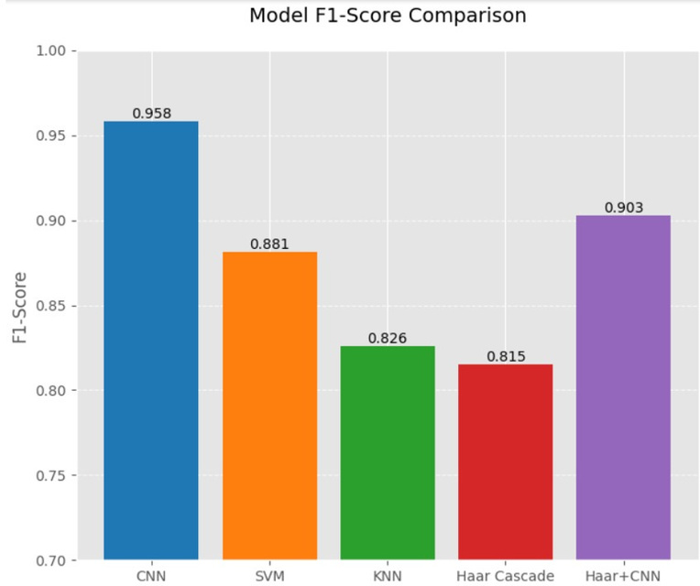
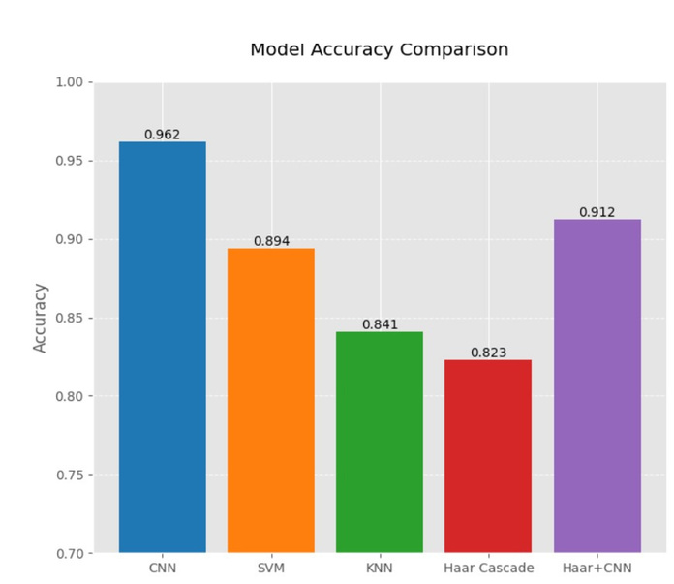
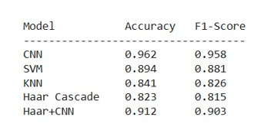
10

Slide 12
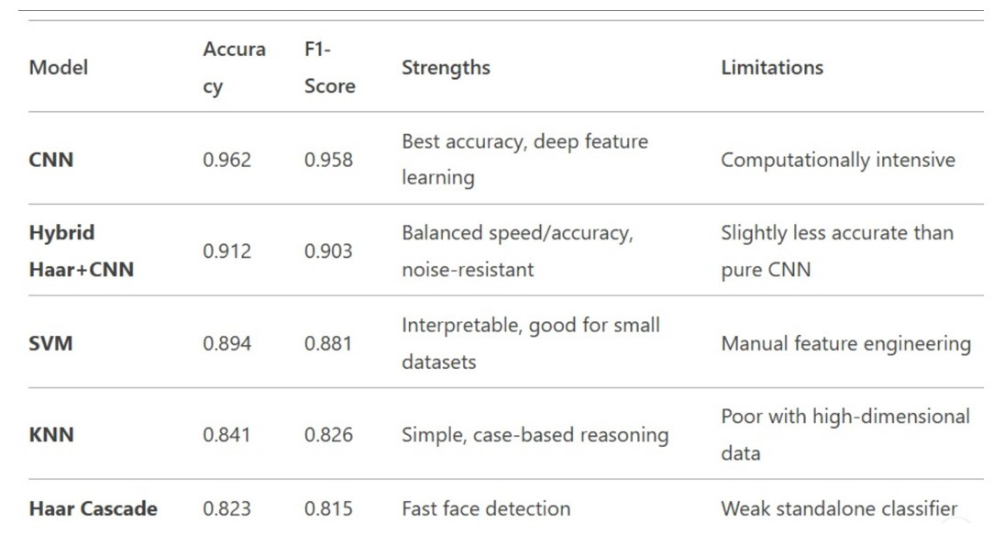

Slide 13
CONCLUSION -
This research presents a hybrid machine learning framework combining multimodal biometrics—CNNs, Haar Cascade, and classifiers like SVM and KNN—for improved skin disease detection. Applied to the "20 Skin Disease Directories with Face Images" dataset, it effectively identifies conditions like eczema, melanoma, and psoriasis. The approach enhances diagnostic accuracy and reliability while supporting telemedicine and early detection. Future directions include integrating thermal imaging and 3D skin mapping, expanding datasets, and clinical testing to boost robustness and practical use. The study underscores AI's transformative potential in dermatological care.
12

Slide 14
THANK YOU
13

